Slide 1
.NET Programming
Unit 1

Slide 2
Features of .NET Framework
.NET Framework Architecture
CLR (Common Language Runtime)
CTS (Common Type System)
CLS (Common Language Specifications)
Assembly
Private Assembly
Shared Assembly
Metadata
FCL (.NET Framework Class Library)
JIT (Just in time ) Compiler
MSIL (Microsoft Intermediate Language)
GC (Garbage Collector)
Visual Basic .NET

Slide 3
Features of .NET Framework
.NET Framework Architecture
CLR (Common Language Runtime)
CTS (Common Type System)
CLS (Common Language Specifications)
Assembly
Private Assembly
Shared Assembly
Metadata
FCL (.NET Framework Class Library)
JIT (Just in time ) Compiler
MSIL (Microsoft Intermediate Language)
GC (Garbage Collector)
Visual Basic .NET

Slide 4
Features of .NET Framework
Rich Framework set of Classes
Pure Object Oriented Programming System
Memory Management
Multi-language and Multi-device support
Easy and Faster Development
Ease of Deployment and configuration
XML support
Multi Threading
Delegation and Event Management

Slide 5
Features of .NET Framework
.NET Framework Architecture
CLR (Common Language Runtime)
CTS (Common Type System)
CLS (Common Language Specifications)
Assembly
Private Assembly
Shared Assembly
Metadata
FCL (.NET Framework Class Library)
JIT (Just in time ) Compiler
MSIL (Microsoft Intermediate Language)
GC (Garbage Collector)
Visual Basic .NET

Slide 6
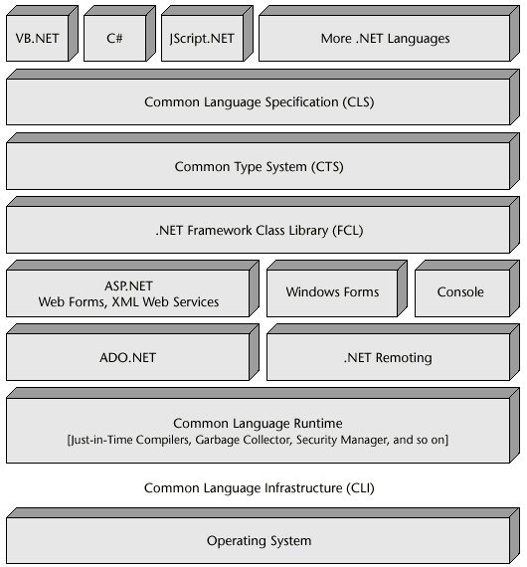
.NET Framework Architecture

Slide 7
Features of .NET Framework
.NET Framework Architecture
CLR (Common Language Runtime)
CTS (Common Type System)
CLS (Common Language Specifications)
Assembly
Private Assembly
Shared Assembly
Metadata
FCL (.NET Framework Class Library)
JIT (Just in time ) Compiler
MSIL (Microsoft Intermediate Language)
GC (Garbage Collector)
Visual Basic .NET

Slide 8
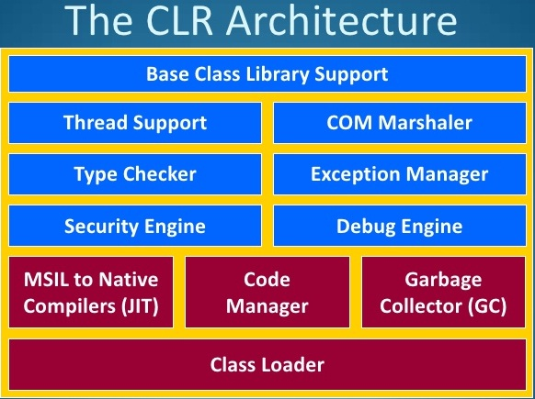
Common Language Runtime (CLR)

Slide 9
Common Language Runtime (CLR)
CLR works like a virtual machine in executing all languages.
All .NET languages must obey the rules and standards imposed by CLR
Class Loader
MSIL(Microsoft intermediate Lang) to Native code
Code Manager
Garbage Collector
Thread Support
Exception Handler
Access Security
Object declaration, creation and use

Slide 10
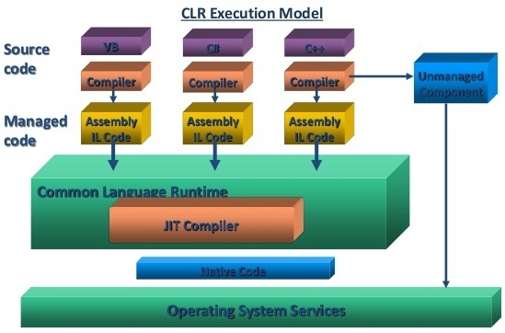

Slide 11
Managed Code
Unmanaged Code
Code Executed by CLR
Code Compiled into MSIL
at Runtime provides
Security
Type Checking
Exception Handling
GC
Code Executed by OS
Code compiled into Native Language
Programmer need to handle these manually

Slide 12
Features of .NET Framework
.NET Framework Architecture
CLR (Common Language Runtime)
CTS (Common Type System)
CLS (Common Language Specifications)
Assembly
Private Assembly
Shared Assembly
Metadata
FCL (.NET Framework Class Library)
JIT (Just in time ) Compiler
MSIL (Microsoft Intermediate Language)
GC (Garbage Collector)
Visual Basic .NET

Slide 13
Common Type System (CTS)
Cross Language Integration
Class written in C# should be equivalent to class written in VB.NET
Implement various types (int, double, etc.)
Common Types
Value Types
Reference Types

Slide 14
Features of .NET Framework
.NET Framework Architecture
CLR (Common Language Runtime)
CTS (Common Type System)
CLS (Common Language Specifications)
Assembly
Private Assembly
Shared Assembly
Metadata
FCL (.NET Framework Class Library)
JIT (Just in time ) Compiler
MSIL (Microsoft Intermediate Language)
GC (Garbage Collector)
Visual Basic .NET

Slide 15
Common Language Specifications (CLS)
Guideline for all the available languages
Basic common syntax
Subset of Common Type System (CTS)
Interact with Objects written in Other languages and share information.

Slide 16
Features of .NET Framework
.NET Framework Architecture
CLR (Common Language Runtime)
CTS (Common Type System)
CLS (Common Language Specifications)
Assembly
Private Assembly
Shared Assembly
Metadata
FCL (.NET Framework Class Library)
JIT (Just in time ) Compiler
MSIL (Microsoft Intermediate Language)
GC (Garbage Collector)
Visual Basic .NET

Slide 17
Assembly
Collection of DLLs and EXE files
Assembly Information stored in it’s manifest file.
Private Assemblies
Integrated with each Applications
Public/Shared Assemblies
GAC (Global Assembly Cache)
SNK (Strong Name Key)

Slide 18
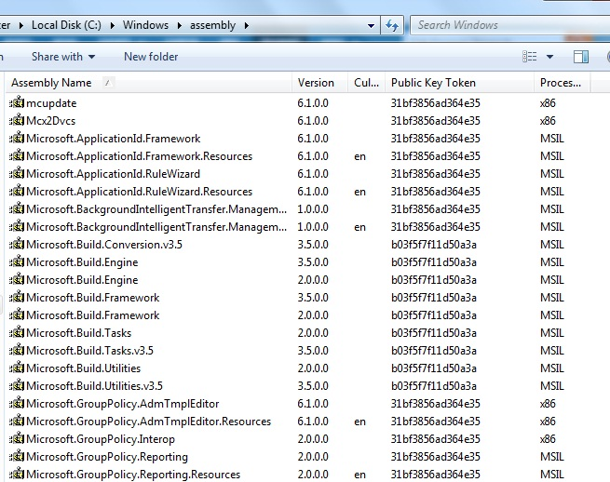
GAC

Slide 19
Features of .NET Framework
.NET Framework Architecture
CLR (Common Language Runtime)
CTS (Common Type System)
CLS (Common Language Specifications)
Assembly
Private Assembly
Shared Assembly
Metadata
FCL (.NET Framework Class Library)
JIT (Just in time ) Compiler
MSIL (Microsoft Intermediate Language)
GC (Garbage Collector)
Visual Basic .NET

Slide 20
Metadata
Data about Data
Binary information which describes the characteristics of a resource
During the compile time Metadata created with Microsoft Intermediate Language (MSIL) and stored in a file called a Manifest
Assembly Name
Version
Culture
Token Key
Processor Architecture
references it to discover information about your code's classes, members, inheritance, and so on

Slide 21
Features of .NET Framework
.NET Framework Architecture
CLR (Common Language Runtime)
CTS (Common Type System)
CLS (Common Language Specifications)
Assembly
Private Assembly
Shared Assembly
Metadata
FCL (.NET Framework Class Library)
JIT (Just in time ) Compiler
MSIL (Microsoft Intermediate Language)
GC (Garbage Collector)
Visual Basic .NET

Slide 22
FCL / BCL Framework Class Library Base Class Library
FCL / BCL
User Defined Class Library
Pre Defined Class Library
Assembly
Namespace (System)

Slide 23
Features of .NET Framework
.NET Framework Architecture
CLR (Common Language Runtime)
CTS (Common Type System)
CLS (Common Language Specifications)
Assembly
Private Assembly
Shared Assembly
Metadata
FCL (.NET Framework Class Library)
JIT (Just in time ) Compiler
MSIL (Microsoft Intermediate Language)
GC (Garbage Collector)
Visual Basic .NET

Slide 24
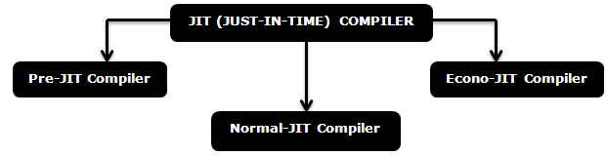
JIT (Just In Time Compiler)
Compile MSIL to Native Code

Slide 25
Features of .NET Framework
.NET Framework Architecture
CLR (Common Language Runtime)
CTS (Common Type System)
CLS (Common Language Specifications)
Assembly
Private Assembly
Shared Assembly
Metadata
FCL (.NET Framework Class Library)
JIT (Just in time ) Compiler
MSIL (Microsoft Intermediate Language)
GC (Garbage Collector)
Visual Basic .NET

Slide 26
MSIL (Microsoft Intermediate Language)
CPU independent instruction code
Used by CLR
Object loading, storing, initialization, calling methods and subroutines, memory access, exception handling and control flow.
Same performance for all the .NET languages.

Slide 27
Features of .NET Framework
.NET Framework Architecture
CLR (Common Language Runtime)
CTS (Common Type System)
CLS (Common Language Specifications)
Assembly
Private Assembly
Shared Assembly
Metadata
FCL (.NET Framework Class Library)
JIT (Just in time ) Compiler
MSIL (Microsoft Intermediate Language)
GC (Garbage Collector)
Visual Basic .NET

Slide 28

GC ( Garbage Collection)
Automatic reclamation of memory space used by objects that are no longer useful
Generally Slower than manual reclamation, but eliminates a very frequent programming errors.

